Slide 1



MOVIES AND TV SHOWS Recommendation System
DINA ALSHEHRI
Data Science Bootcamps for SDAIA Academy
Notes:
Recommendation system is one of interesting applications in Data Science. In this project, I'm going to create a simplified recommendation system for Netflix movies and tv shows based on genres.

Slide 2

Outline
INTRODUCTION
DESIGN AND DATA
ALGORITHMS
TOOLS
COMMUNICATION
Data Science Bootcamps for SDAIA Academy.

Slide 3


INTRODUCTION
EDA
Content-Based Recommendation
Exploratory Data Analysis to know and describe the data in a better way through interactive graphs and visualizations.
A content-based recommendation engine for movies and TV shows on Netflix is presented.
Notes:
First an Exploratory Data Analysis (EDA) will be presented to understand and describe the data in a better way through interactive graphs. After that, a recommendation engine for Movies and TV shows on Netflix is demonstrated.
Visualization would enable a better understanding of the most content type on Netflix movies or TV shows and the variety of Content by Rating. Also, the highest amount of content produced by country. Another aspect is to identify the most popular director on Netflix with the most titles.on the another hand, Recommendation model, is proposed to find Movies and TV Shows users might like based in history.

Slide 4

DESIGN
The project will be on predicting Netflix Movies and TV Shows based on personal history viewing using recommendation system.
In order to help understand people preference and how Netflix generate similar catalog of movies and TV shows using genres, title, and release year as features.
Data Science Bootcamps for SDAIA Academy.
Notes:
Netflix Main business is its subscription-based streaming service, which provide online streaming of a collection of films and television series, including those produced in-house..
Netflix use those predictions to make personal movie and tv shows recommendations based on each customer’s unique tastes..

Slide 5

DATA
DATASET CONTAINS 12 COLUMNS FOR EXPLORATORY ANALYSIS WITH 8807 RECORDS
FEATURES:
show_id: unique id of each show
type: The category of a show, can be either a Movie or a TV Show
title: Name of the show
director: Name of the director(s) of the show
cast: Name of actors and other cast of the show
country: Name of countries the show is available to watch on Netflix
date_added: Date when the show was added on Netflix
release_year: Release year of the show
rating: Show rating on netflix
duration: Time duration of the show
listed_in: Genre of the show
description: Some text describing the show
Data Science Bootcamps for SDAIA Academy.
Notes:
The data I used is TV Shows and Movies listed on the Netflix dataset from Kaggle

Slide 6
ALGORITHMS
CLEANING THE DATASET
dropna() to drop any row with null value
Imputation
fillna function
Notes:
I used dropna() to drop any row with null value.There are a total of 4,307 null values across the entire dataset with 2,634 missing points under "director", 825 under "cast", 831 under "country", 10 under "date_added", and 4 under "rating".
Imputation is used as a treatment method for missing value in this project by filling it In this module,I used the fillna function from Pandas for this imputation. Drop rows containing missing values. Can use the dropna function from Pandas
For missing values, since "director", "cast", and "country" contain the majority of null values, we chose to treat each missing value is unavailable. The other two label "date_added" and "rating" contain an insignificant portion of the data so it drops from the dataset. Finally, there are no more missing values in the data frame.

Slide 7
ALGORITHMS
Content-based Filtering
MinMaxScaler
Recommender Systems
Nearest Neighbour Algorithm
Uses similarities in features to make decisions
To Calculate The “Distance” Between The Target Tv Show
Transform features by scaling each feature to a given range
Notes:
For this recommender system I used Content-based Filtering technique to find the similarity between content that the user has already consumed and the recommended.
Content-based Filtering is a Machine Learning technique that uses similarities in features to make decisions. This technique is often used in recommender systems, which are algorithms designed to advertise or recommend things to users based on knowledge accumulated about the user.
I appled the The nearest neighbour algorithm model to calculate the “distance” between the target tv show and every other tv show in the database (nearest 5), then it ranks its distances and returns the top K nearest neighbor tv show as the most similar tv show recommendations
I normalize the data by scaling each feature to a given range between zero and one min-max scaling.
MinMaxScaler. Transform features by scaling each feature to a given range. This estimator scales and translates each feature individually such that it is in the given range on the training set, e.g. between zero and one.
Normalization refers to the rescaling of the features to a range of [0, 1], which is a special case of min-max scaling. To normalize the data, the min-max scaling can be applied to one or more feature columns

Slide 8
TOOLS
NUMPY
PANDAS
MATPLOTLIB
SEABORN
SKLEARN.LINEAR_MODEL
Notes:
THESE ARE SOME OF THE Python library USED in this project for modeling to build data science models

Slide 9
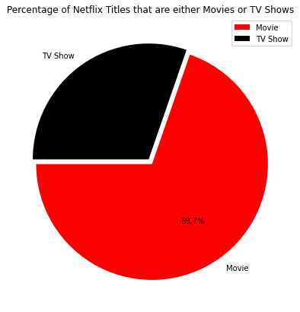
CONCLUSIONS
The most content type on Netflix is movies
Notes:
We have drawn many interesting inferences from the dataset Netflix titles, here's a summary of the few of them:
Netflix primarily lists two types of contents -movies and TV-shows on their streaming site.
As shown in the Pie chart above it is evident that there are more Movies on Netflix than TV shows.

Slide 10
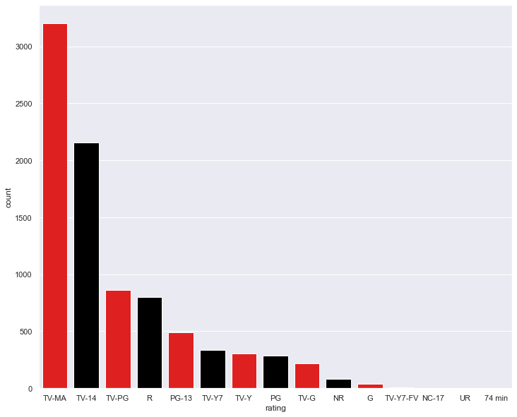
CONCLUSIONS
The largest count of Movies and TV shows is made with a "TV-MA" rating
Notes:
majority of Netflix content whether movies or TV-shows are rated TV-MA. This type of contents are for mature, adult audiences and therefore unsuitable for children. The second highest type of contents are for children that are 14 year-old and above. These are rated TV-14

Slide 11
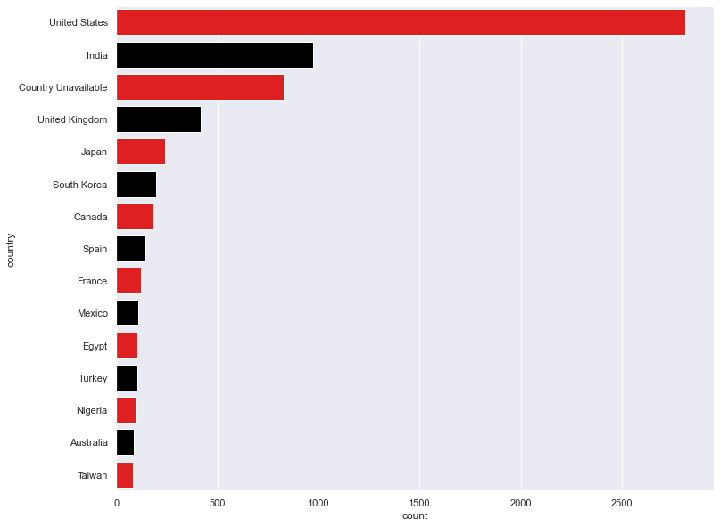
CONCLUSIONS
United States have highest rated content on the Netflix.
Notes:
United States have highest rated content on the netflix.

Slide 12
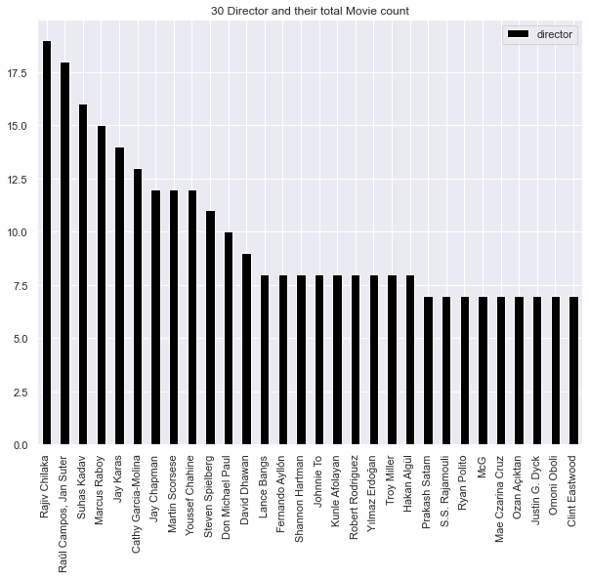
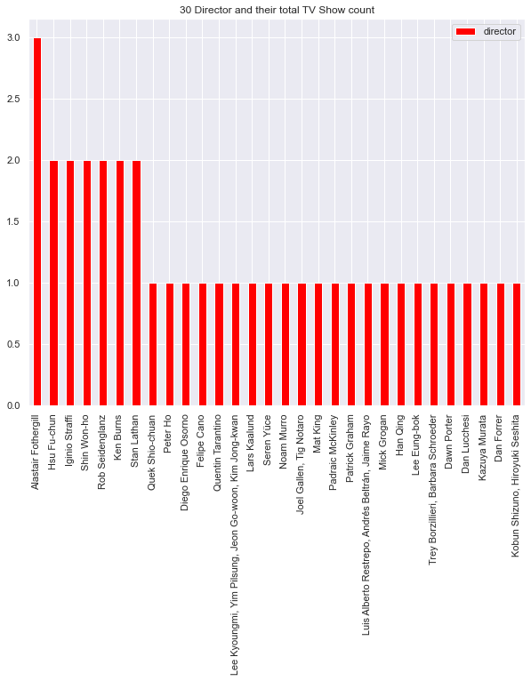
CONCLUSIONS
The most popular director on Netflix with the most titles
Rajiv Chilaka (Movie)
Alastair Fothergill (TV Show)
Notes:
The most popular director on Netflix with the most titles
Rajiv Chilaka (Movie)
Alastair Fothergill (TV Show)

Slide 13
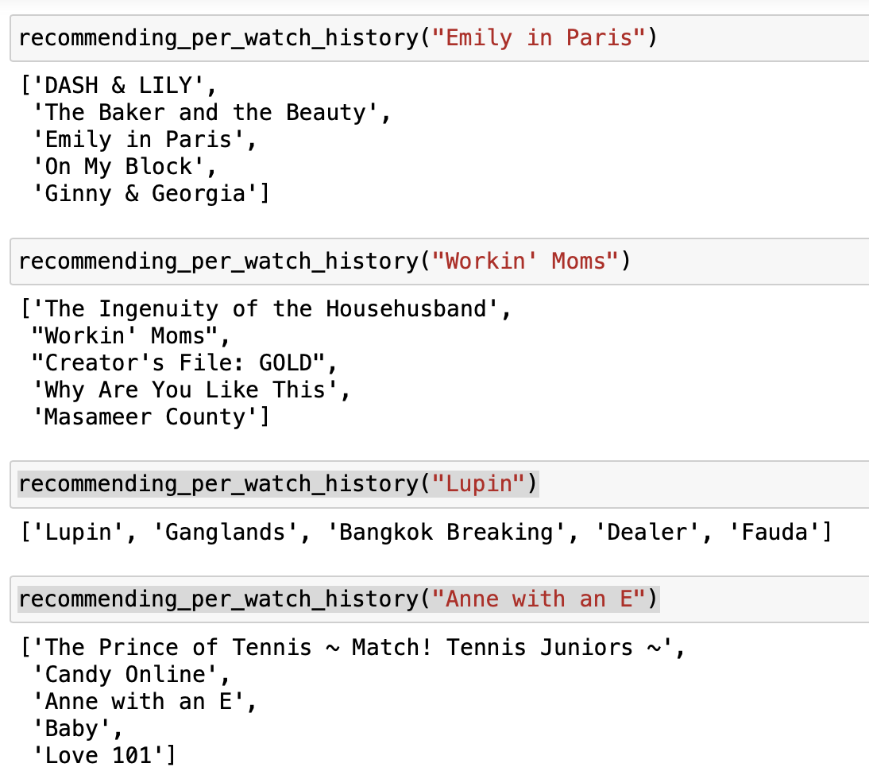
CONCLUSIONS
Notes:
AT THE END, THE Model Looks good. The system recommends similar appropriate TV SHOWS for the same TV SHOW BASED ON HISTORY, concerning similar genres.

Slide 14
REFERENCES
Kaggle.com. 2021. Netflix Movies and TV Shows. [online] Available at: <https://www.kaggle.com/shivamb/netflix-shows> [Accessed 25 November 2021].

Slide 15
Thank
You
Notes:
To get better result more algorithm models will be applied in the second stage like
The collaborative filtering algorithm where it will use “User Behavior” for recommending.

